Slide 1

10–POINT COLLEGE
DEVELOPMENT
AGENDA

Slide 2

1. COLLEGE WITH HIGH REPUTATION
Recipient of awards and recognition for outstanding performance
in instruction, research, community extension and training.
Programs are accredited towards the highest levels across organic
campuses
Rec ip ient of ISO a ccredita tion
Producer of topnotchers and exemplary graduates who are
competitive both in national and global levels
Active membership to organizations that are prime movers for
progressive change and development
Strong partnerships with national, regional and local institutions to
undertake research technical trainings and community extension

Slide 3

2. TOWARDS A
UNIVERSITY STATUS
Strong support to any congressional initiative
that seeks to convert the College into a State
University
Compliance with CHED criteria for higher
educa tion in stitu tion s (HEIs) applying for the
horizontal type “UNIVERSITY”

Slide 4

3. QUALITY EDUCATION FOR SERVICE
Strengthening the College Flagship Programs
Agriculture, Teacher Education, Arts and Sciences and Technology Courses
Aligning and harmonizing College initiatives with:
Susta ina ble Developm ent Goa ls (SDGs) of the U nited Na tions
Ambisyon Natin 2040 – Prosperous country, Middle class (no one is poor),
People live in long and healthy lives, Live in High Trust Society, Smart and
Innovative
Philippine Development Plan and the Zamboanga Peninsula Regional
Development Plan
Any national higher education agenda

Slide 5

4. GOOD GOVERNANCE
Integrity
Adherence to RA 3019 (Anti-Graft and Corrupt Practices Act of
the Philippines
Adherence to Code of Conduct set by the Civil Service Commission
Ensure submission of SALN of personnel
Accessibility and Inclusiveness
Implementation of the Citizen’s Charter
Initiate giving greater access to poor but deserving students through
scholarships and incentives.
Utilize College scholars, experts and specialists as consultants to various
programs and projects being conceptualized for proposal or implementation.
Espouse democratic, participatory, results – oriented and transparent
governance.

Slide 6

M anagement E ffec tiven ess
Attainment of College Vision, Goals and Objectives
Accomplishment of organizational performance output and outcome
indicator targets through the Service Delivery Units
Implementation of JHCSC Land Use Development and Infrastructure Plan in
a ccorda nce w ith Rep ub lic Act No. 11396
Implementation of existing College plans mainstreaming digitalization, smart
campus and futures thinking
Support to HR development through re-tooling, training, capability building
and capacity enhancement
Increase in incomes and revenues through efficient management of resources
and expenditures and enter into joint ventures with business and industry for
the profitable development and management of the economic assets of the
College
Internal control and efficiency in operations through the Internal Control
Officer

Slide 7

Propose development and regulatory policies to carry out the mandated
functions of the College
Help appropriate the financial and other resources to various campuses,
offices and units of the College
Aim for the provision/ construction or repair of its buildings, machineries,
equipment and other facilities and the purchase and acquisition of real
properties, including necessary supplies, materials and equipment.
Stimulate empowerment to appointed and designated officials of the College
Recommend restructuring proposals of the College to become more efficient,
relevant, productive, and competitive
Recommend curriculum enhancement and institutional programs and
projects to the Administative and Academic Councils and Committees.

Slide 8
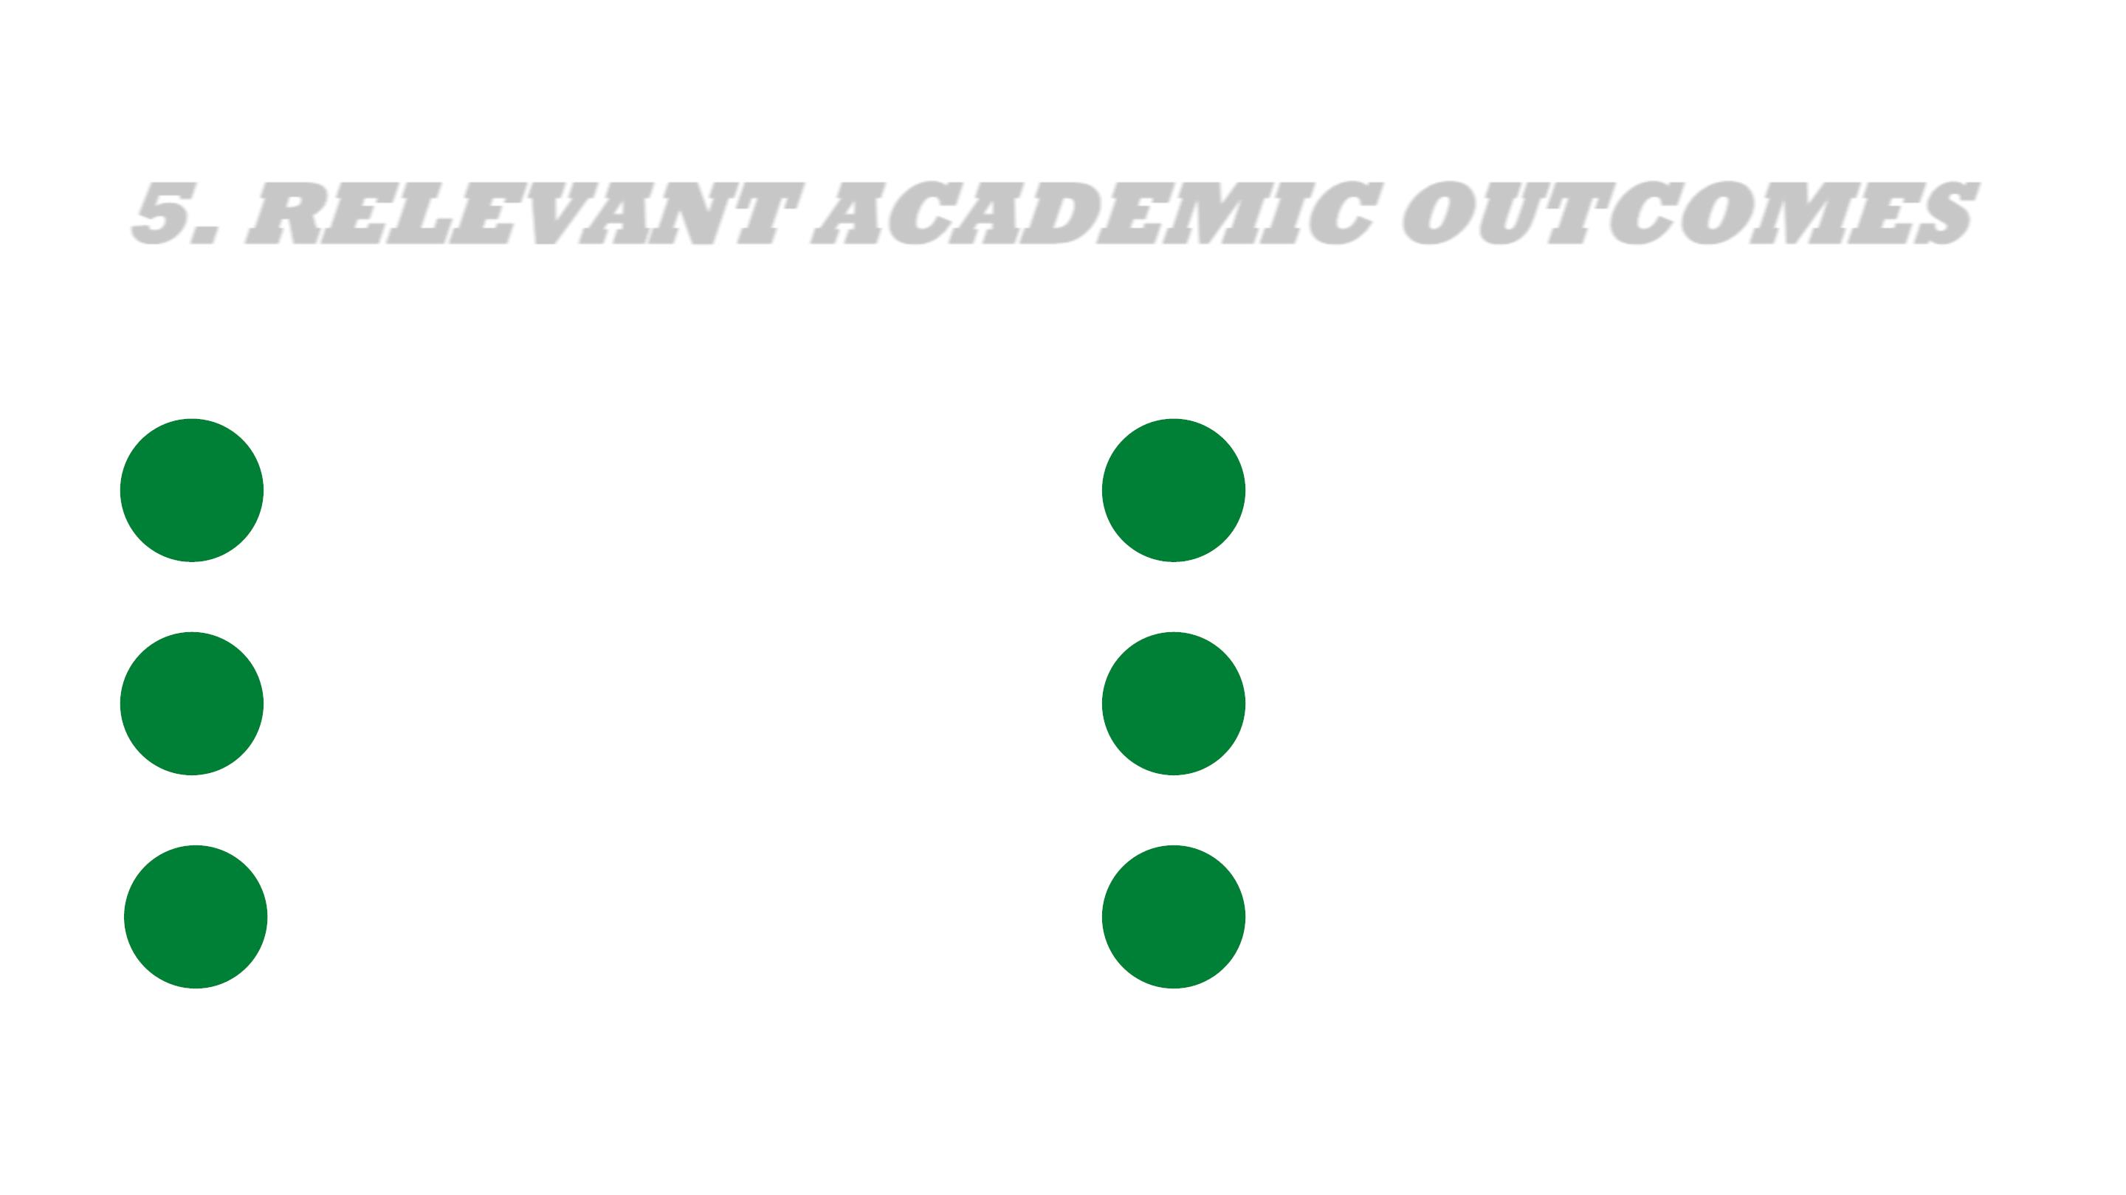
5. RELEVANT ACADEMIC OUTCOMES
Adopt modern and innovative
1
2
3
approaches, strategies and methods
to enhance delivery of services and
quality higher education.
4
5
6
Curric ulum upgra ding
Sending faculty for professional
advancement
Help establish chairs and fellowships
for qualified faculty members
Provide institutional scholarships
P roducing m ore top notchers

Slide 9

6. RESEARCH AND DEVELOPMENT
ADVANCEMENT
Support for long term academic, research and extension and
administrative programs related to development, efficiency and
sustainability.
Enha ncing ca pa bility
Organizational culture for productive research
Increase resource base for research services
Incentives for faculty with research projects and publications
Recognizing and rewarding research performances
Im prove resea rc h fa c ilities
R & D fa cility m oderniza tion progra m
Establishment of partnerships for collaborative research
among colleges/universities, line agencies, LGUs, NGOs and
international funding agencies

Slide 10

7. ADVANCING COMMUNITY AND EXTENSION
ENGAGEMENT
Enhancing capability and organizational culture for productive
extension activities
Economically sound and sustainable livelihood programs
Enhancing fiscal resource base for extension
Increa sing p a rtnership s w ith NLAs (TESDA, NEDA, DA, etc.) and LGU s
Develop spirit of volunteerism among faculty, staff and students
through capability enhancement program

Slide 11

8. PEOPLE EMPOWERMENT
HR M anagement
Developing strong, competent faculty and staff
Providing benefits: incentives and benefits for faculty and staff performing
multiple functions of research, extension, production and administration
Implementing PRAISE
Introduce Health Plan through College Infirmary Services
Upgrading health plan and medical services
Support to FASA and JHCSC MPC
Effecting SPMS
Qua lity Student Affa irs
Wholesome and holistic development
Provide relevant and comprehensive programs for competitiveness and
leadership skills
Linkages and networks with outside agency

Slide 12

9. LINKAGE AND
NETWORK BUILDING
Establish productive collaborations with other
other institutions, both private and public,
national and international, to advance the
interests of the College
Help establish networks for trust legacies, gifts,
donations, etc.by esp ousing the tax exem ptions and
deductions from the income tax of the donor.

Slide 13

10. RESOURCE MANAGEMENT
GENERATION
External sourcing of funds
Develop self –reliance to reduce dependence on GAA funds
Increasing IGP
Provide sector funding sources – philanthropists, alumni,
donations and endowment funds

